Slide 1

Automated Radiology Report Generation using Vision-Language Models
FULL MARKS
Yuting Fang (z5518340)
Zhiwei Guo (z5550962)
Peidong Liang(z5603156)
Lingxiao Jiang(z5562632)
Jiabei Wu (z5597215)

Slide 2
Introduction
Yuting Fang z5518340

Slide 3
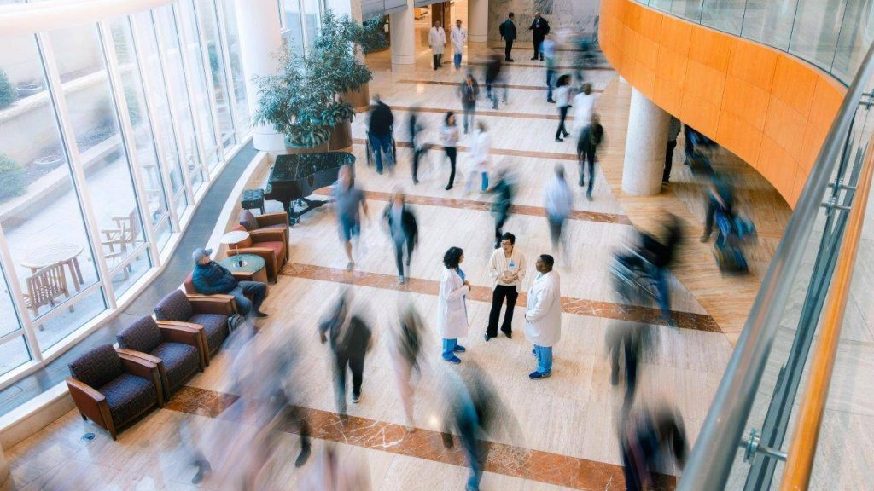
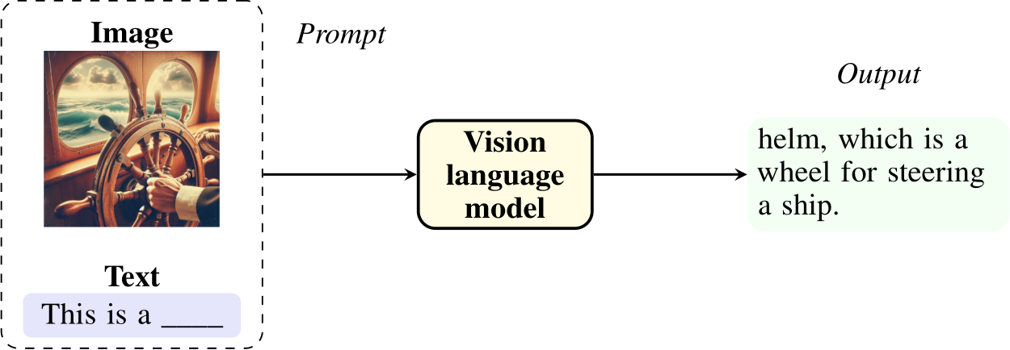
Motivation
Why we use AI in medical science?
Automated Radiology Report Generation
What is the Vision-Language Model?
Presenter: Yuting Fnag (z5518340)

Slide 4
Literature Review
Bert-Based Structure(Moon et al., 2022)
Medical Vision Language Learner(MedViLL): a novel BERT-based multimodal architecture designed for comprehensive vision-language representation learning in the medical domain.
CheXNet(DenseNet121)(Rajpurkar et al., 2017)
A vision model based on the DenseNet121 architecture, which is pre-trained on large-scale chest X-ray datasets (such as Chest X-ray14)
ResNet101(Cohen et al., 2021)
Deep convolutional neural network, and Pre-trained by the author
Presenter: Yuting Fang(z5518340)

Slide 5
Literature Review
Vision Transformer(ViT) (Tayebi Arasteh et al., 2024)
Pre-trained on the large-scale ImageNet-21k dataset and outperforms in the medical-image analysis area.
Clinical T5 (Lehman et al., 2023)
A domain-specific language generation model with a transformer-based structure, trained on a large corpus of clinical notes and radiology reports.
Presenter: Yuting Fang(z5518340)

Slide 6
Problem Statement
Develop a deep learning-based system that generates automated radiology reports from chest X-ray images (MIMIC)
Using a transformer-based vision-language model(BERT-Based Model)
Inputs: Chest X-ray image
Outputs: Comprehensive radiology report
We will try to tweak the model with a Bert-Based structure, which is cited from the Model MedViLL.
Accurate description of the findings
Follow professional diagnostic standards
Ensure the coherence and clinical relevance
Presenter: Yuting Fang (z5518340)

Slide 7
WorkFlow
Build Advance Model
Discussion & Conclusion
stage1
stage3
stage2
stage4
Data processing
Evaluate & interpret models
Presenter: Yuting Fang(z5518340)

Slide 8
Dataset
Lingxiao Jiang z5562632

Slide 9
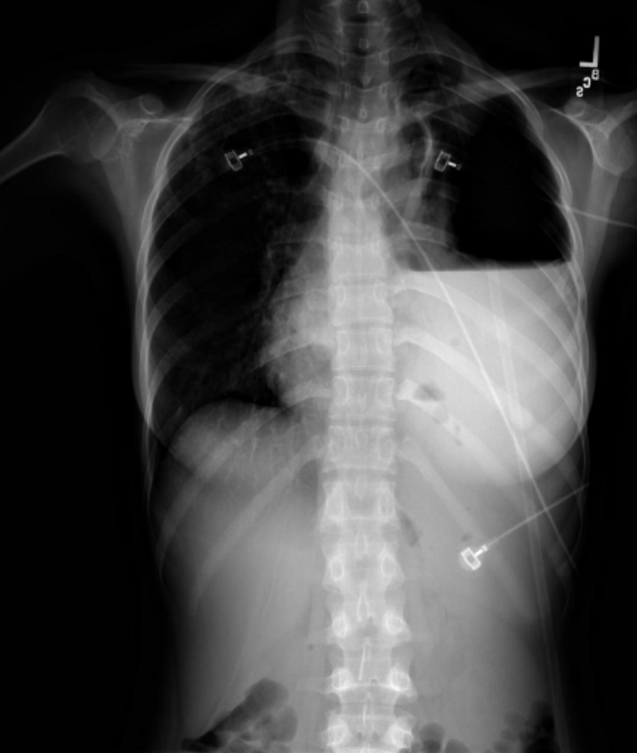
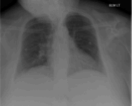
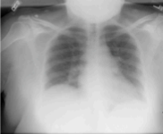
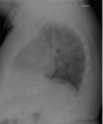
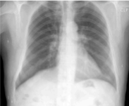
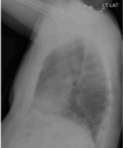
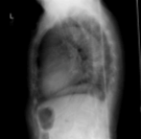
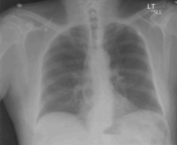
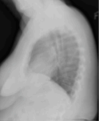
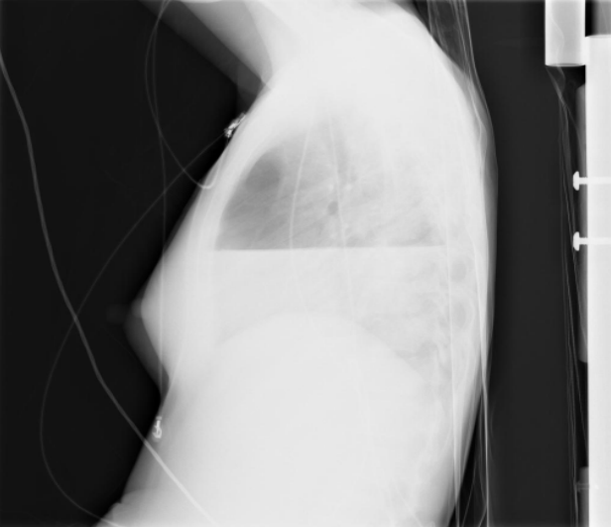
Dataset Source
Images
~10000 images
Presenter: Lingxiao Jiang (z5562632)

Slide 10
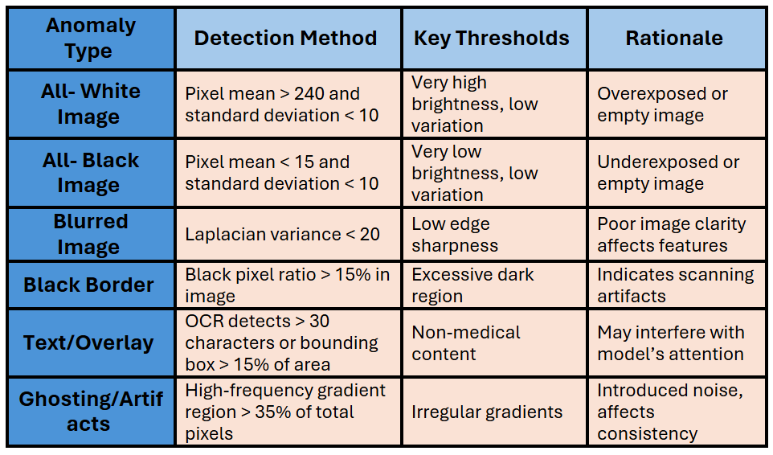
Data Analysis
Find abnormal images
Ghosting / Artifacts
Multiple catheter images were observed to overlap, possibly due to ghosting or device artifacts caused by movement.
Blurred Image
The image has blurred edges, unclear structures, no clear boundaries, and lacks details
Presenter: Lingxiao Jiang (z5562632)

Slide 11
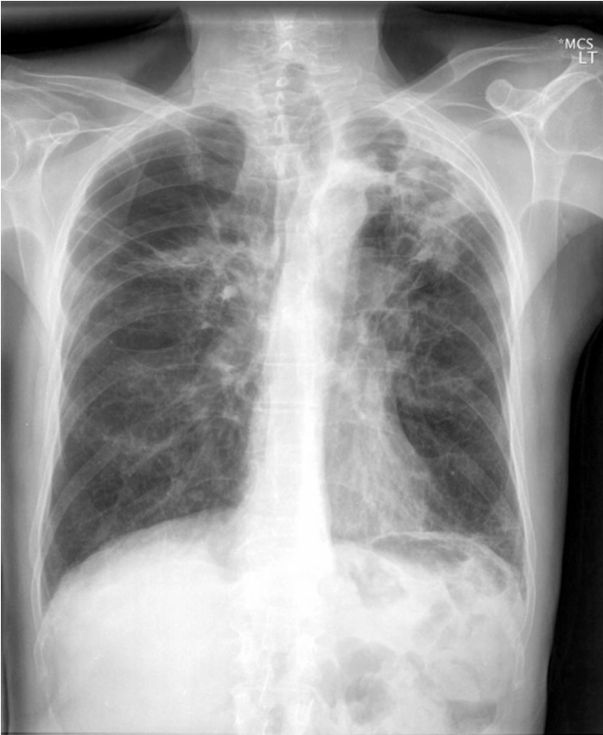
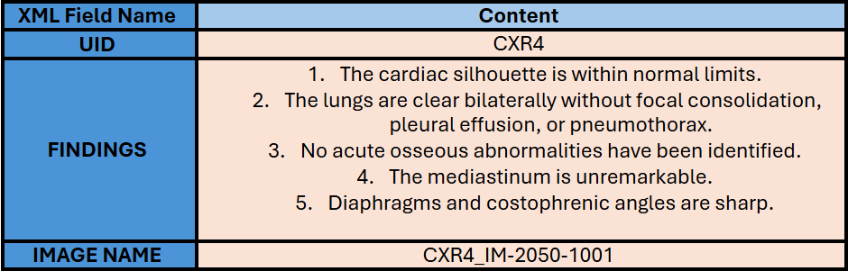
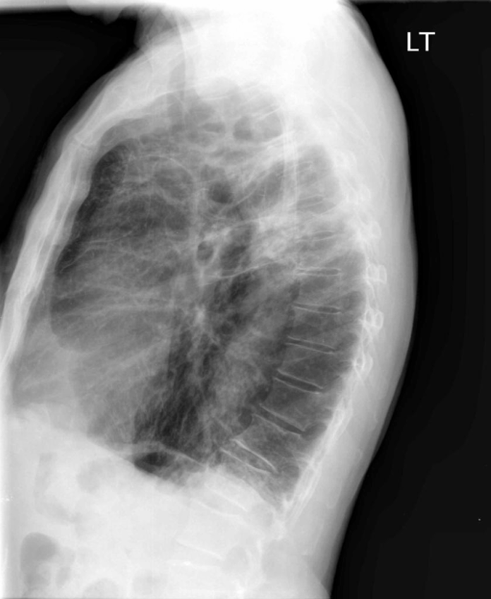
Data Processing
MIMIC-CXR Database
XML Files to CSV File
XML file: Contains report content (such as <FINDINGS> and <impression> tags)
Raw data
Image file: CXR4_IM-2050-1001.jpg
Presenter: Lingxiao Jiang (z5562632)

Slide 12
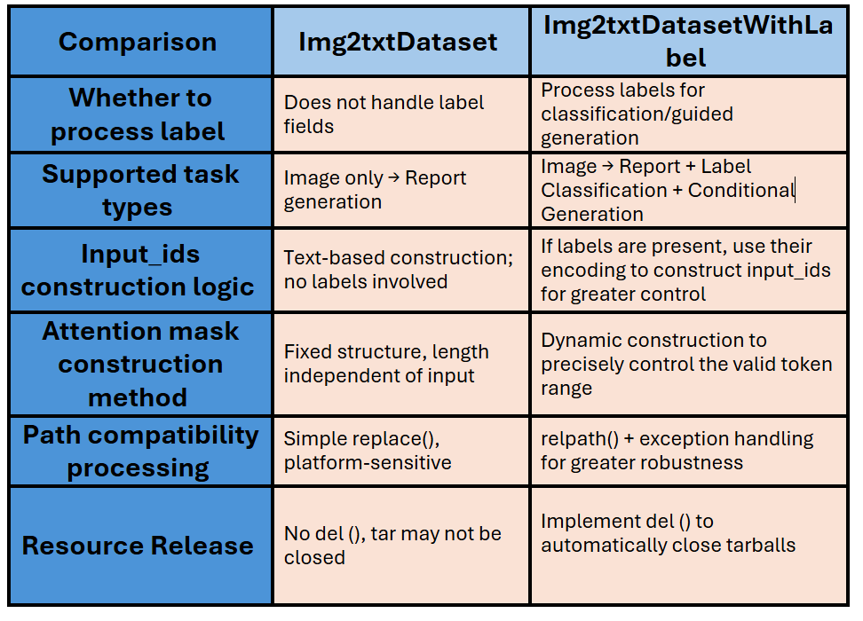
Data Processing
CSV file to JSONL files
Differences:
1. Img2txtDataset(A) vs Img2txtDatasetWithLabel(B)
Does the label field read?
Does the input structure passed to PreprocessSeq2seqGen contain labels?
2. PreprocessSeq2seqGen Version A vs Version B
Does the label tokenize and include input_ids?
Does the attention mask dynamically construct based on the label length?
Does the initialization of self.tar become more explicit?
Does path compatibility and __del__() cleanup mechanisms exist?
Conclusion:Code A is the basic version, supporting only image-to-text generation tasks. Code B is the enhanced version, retaining all image-to-text generation capabilities while incorporating labels, supporting multi-task learning, and providing more robust and flexible preprocessing logic. Code B is recommended as the primary training data loading solution.
Presenter: Lingxiao Jiang (z5562632)

Slide 13
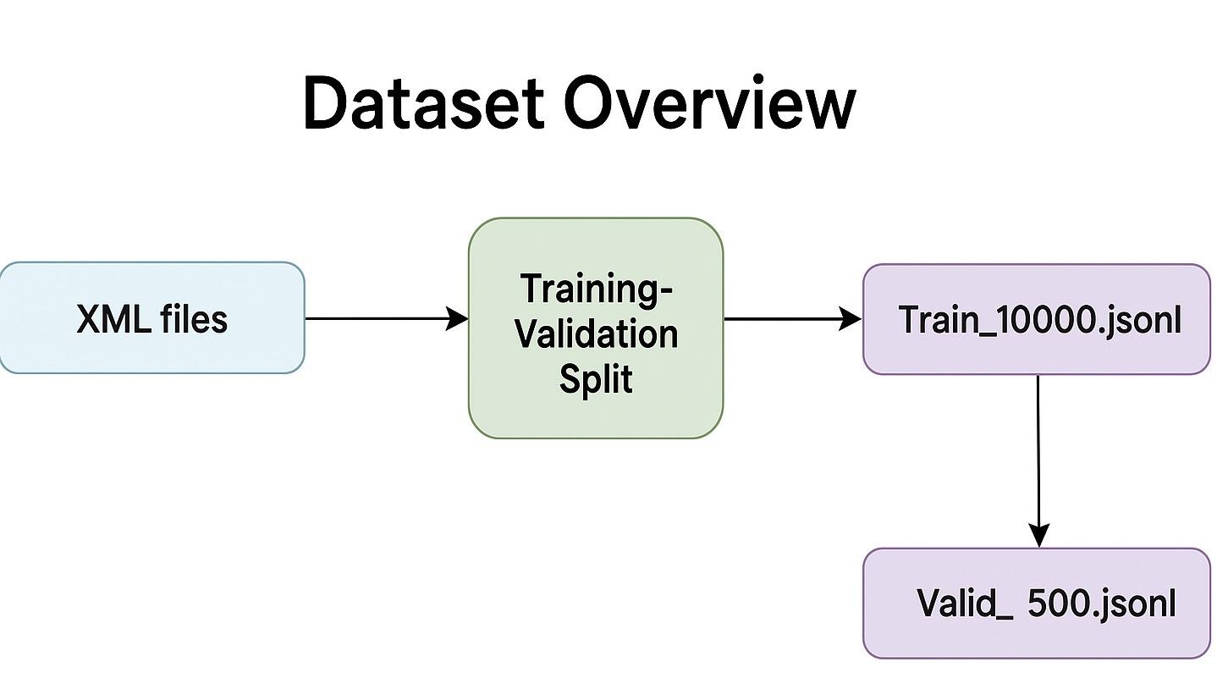
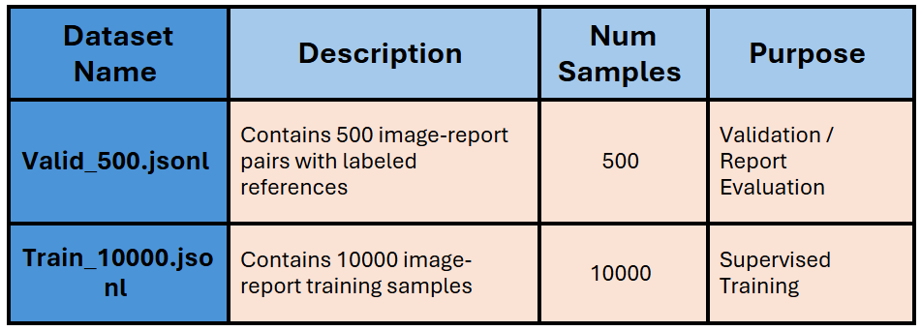
Dataset Overview
Two datasets used in training & evaluation
Train Set — Train_10000.jsonl
Quantity included: 10,000 graphic and text pairing samples
Purpose: Used for main model training to help learn the correspondence between images and reports
Features: The image is a chest X-ray image, and the report is the corresponding clinical description
Validation Set — Valid_500.jsonl
Quantity included: 500 graphic matching samples
Attached label: including the label_text field, which can be used to automatically evaluate the quality of generated reports
Purpose: Used for model tuning performance monitoring, supporting BLEU/ROUGE/BERTScore and other indicators evaluation
Presenter: Lingxiao Jiang (z5562632)

Slide 14
Methodology
Zhiwei Guo z5550962

Slide 15
Image Input Only Network
Chest X-ray Image
Shifted Target report
Visual Feature Extractor
Positional Encoding
Positional Encoding
[CLS]
BERT Image Embeddings
[SEP]
BERT Text Embeddings
[SEP]
Output Embeddings
BERT Layers
Masked Multi-Head Self-Attention + Layer Norm
Multi‑Head Cross‑Attention
Feed‑Forward Network + Layer Norm
Joint Embedding
Linear
Softmax
Output Tokens Probability
Presenter: Zhiwei Guo (z5550962)

Slide 16
Visual Feature Extractor
Options
ResNet101-elastic
CheXNet121
(Base on DenseNet121)
ViT
Presenter: Zhiwei Guo (z5550962)

Slide 17
Image Input Only Network
Chest X-ray Image
Shifted Target report
Visual Feature Extractor
Positional Encoding
Positional Encoding
[CLS]
BERT Image Embeddings
[SEP]
BERT Text Embeddings
[SEP]
Output Embeddings
BERT Layers
Masked Multi-Head Self-Attention + Layer Norm
Multi‑Head Cross‑Attention
Feed‑Forward Network + Layer Norm
Joint Embedding
Linear
Softmax
Output Tokens Probability
Presenter: Zhiwei Guo (z5550962)

Slide 18
Image + Disease Labels Network
Chest X-ray Image
Visual Feature Extractor for classification
Shifted Target report
Visual Feature Extractor
Positional Encoding
Lesion Label
Positional Encoding
[CLS]
BERT Image Embeddings
[SEP]
BERT Text Embeddings
[SEP]
Output Embeddings
Cross-Attention
Masked Multi-Head Self-Attention + Layer Norm
BERT Layers
Multi‑Head Cross‑Attention
Feed‑Forward Network + Layer Norm
Linear
Joint Embedding
Softmax
Output Tokens Probability
Presenter: Zhiwei Guo (z5550962)

Slide 19
Model Architecture Summary
BERT Encoder: Initialized with weights from MEDVILL.
Transformer Decoder: Initialized with weights from Clinical T5.
Model ID | Approach | Visual Backbone | Key Feature / Textual Input
Model 1 | Image-Only Input | ResNet-101-elastic | Uses standard [PAD] tokens
Model 2 | Image-Only Input | CheXNet-121 | Uses standard [PAD] tokens
Model 3 | Image-Only Input | Vision Transformer (ViT) | Uses standard [PAD] tokens
Model 4 | Image + Disease Labels | ResNet-101-elastic | Cross-Attention with labels
Model 5 | Image + Disease Labels | CheXNet-121 | Cross-Attention with labels
Model 6 | Image + Disease Labels | Vision Transformer (ViT) | Cross-Attention with labels
Presenter: Zhiwei Guo (z5550962)

Slide 20
Fine-tuning Strategy
Overall Principle
Visual Feature Extractor: Shallow layers are frozen throughout the process; Only deep layers are fine-tuned to preserve basic feature extraction capabilities while adapting high-level features.
Stage 1: Decoder Alignment (First 5 Epochs)
Objective: To rapidly align the randomly initialized or pre-trained decoder with the specific medical report generation task.
Method:
Encoder: Frozen
Decoder: Fine-tuned
Hyperparameters:
LR (Decoder): 2e-5
Min LR (Decoder): 0.0
Warmup Rate (Decoder): 0.1
Optimizer: AdamW
Batch Size: 4
Stage 2: Full Model Fine-tuning (Next 20 Epochs)
Objective: To jointly optimize the entire model for end-to-end performance improvement after the decoder has been initially aligned.
Method:
Encoder: Unfrozen & Fine-tuned
Decoder: Continues Fine-tuning
Hyperparameters:
LR (Encoder): 5e-5
LR (Decoder): 1e-5
Min LR (Encoder): 1e-4
Min LR (Decoder): 2e-5
Warmup Rate (Encoder/Decoder): 0.1
Optimizer: AdamW
Batch Size: 4
Presenter: Zhiwei Guo (z5550962)

Slide 21
Result
Jiabei Wu z5597215

Slide 22
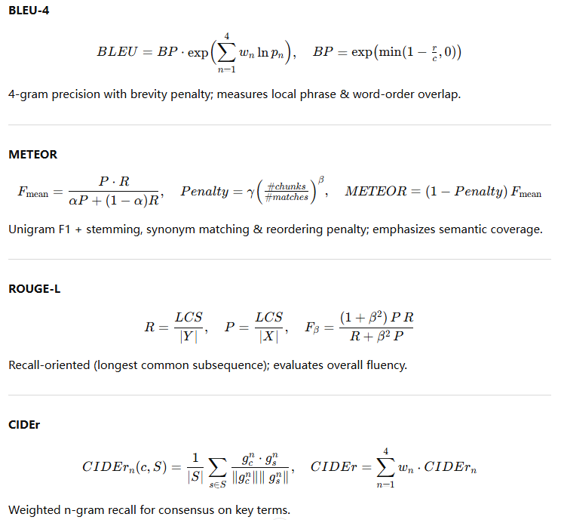
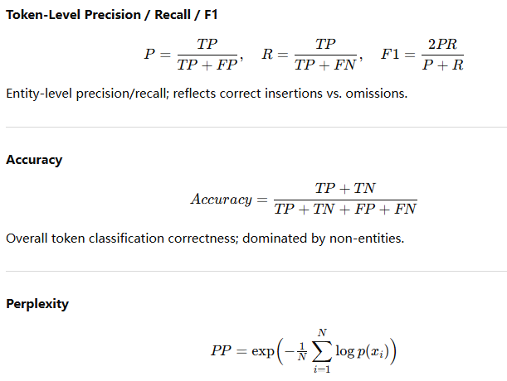
Evaluation
Presenter: Jiabei Wu(z5597215)

Slide 23
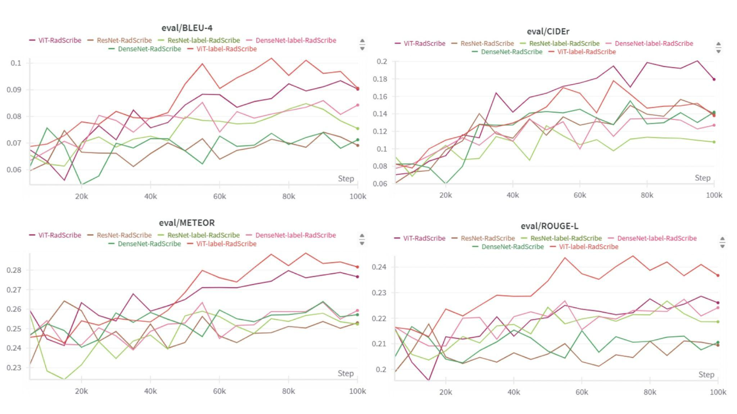
Evaluation Graph
Presenter: Jiabei Wu(z5597215)

Slide 24
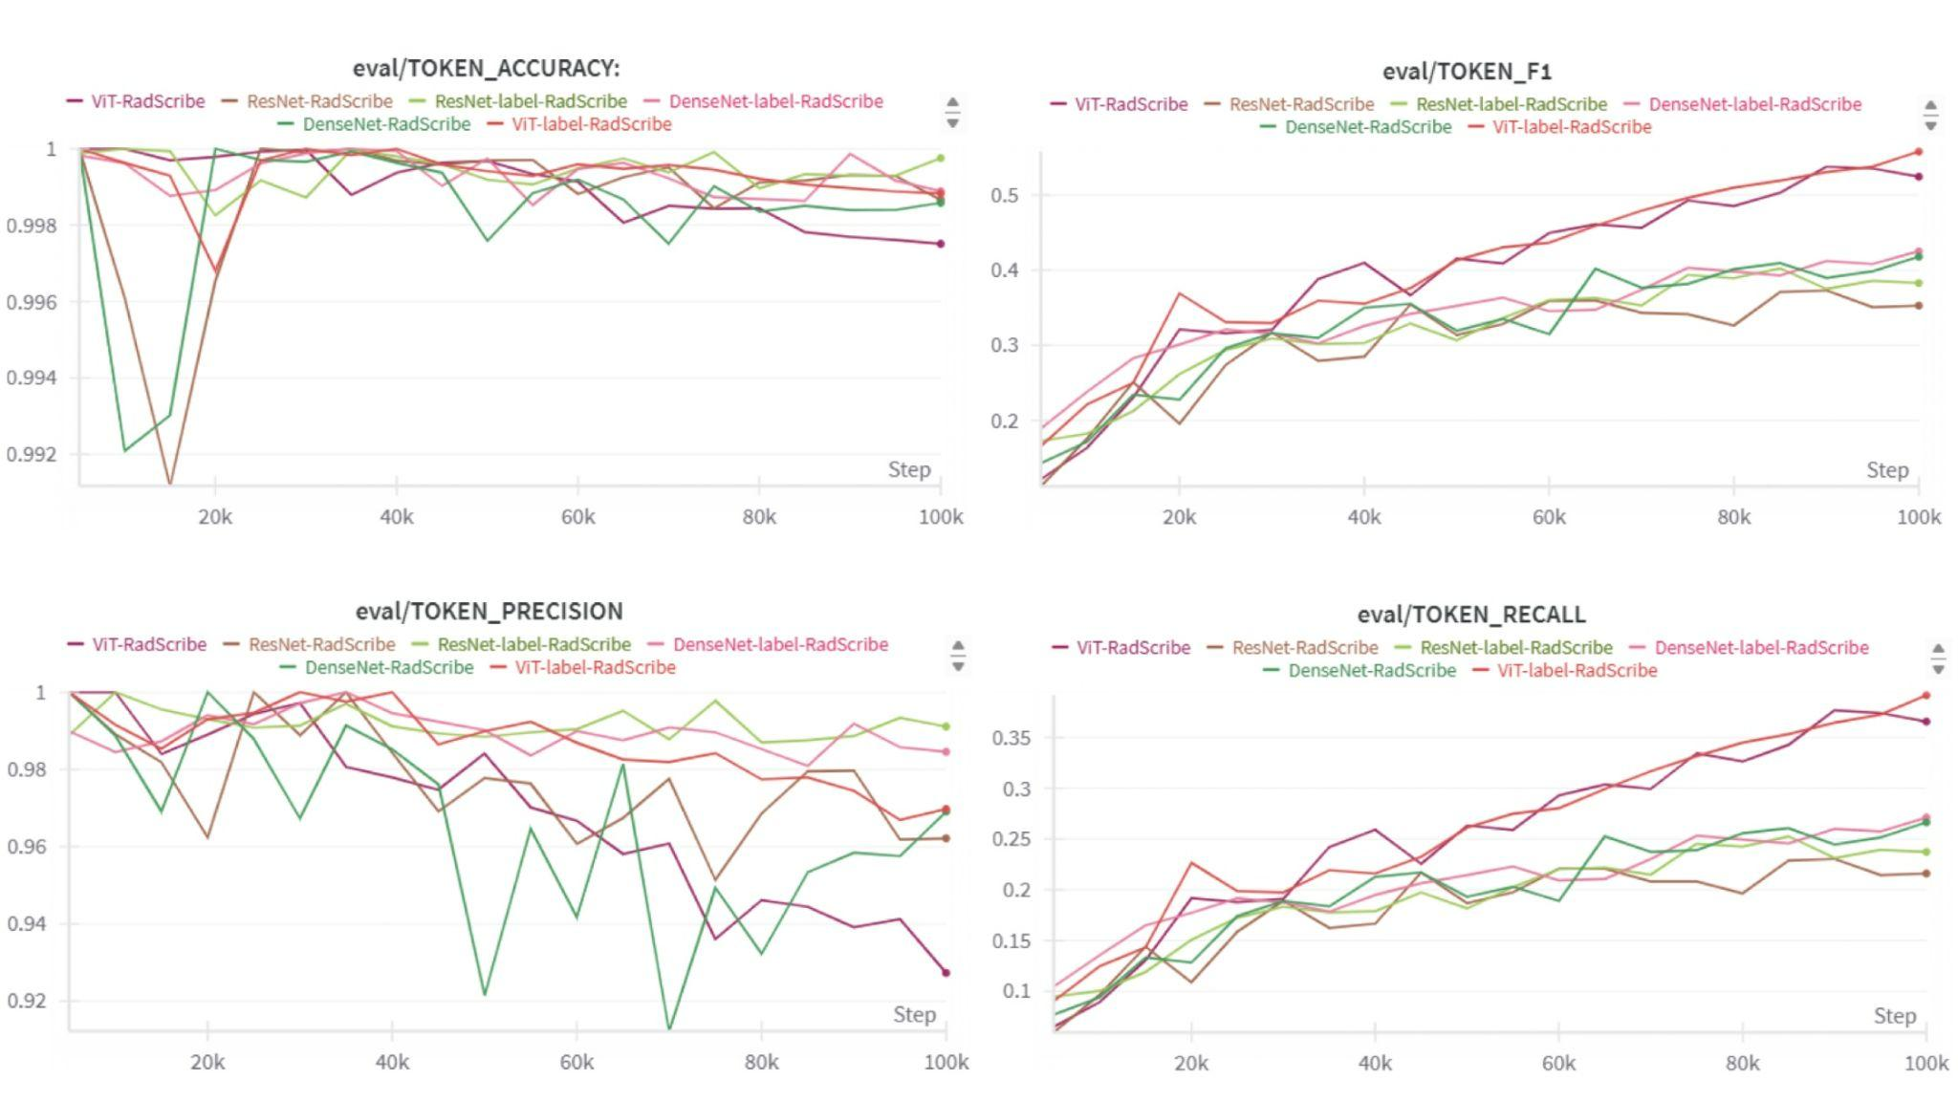
Evaluation Graph
Presenter: Jiabei Wu(z5597215)

Slide 25
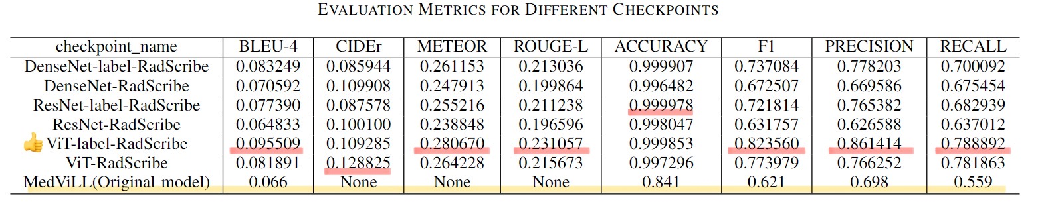
Result
Among all evaluated checkpoints, ViT-label-RadScribe achieves the highest scores on core text-similarity metrics:
BLEU-4: 0.0955
METEOR: 0.2807
ROUGE-L: 0.2311
It also leads in token-level performance with Precision = 0.8614, Recall = 0.7889, and F1 = 0.8236.
Although ResNet-label shows higher accuracy (0.99998 vs. 0.99985) due to background tokens, and ViT-RadScribe has a higher CIDEr (0.1288 vs. 0.1093), ViT-label-RadScribe outperforms both in all other key metrics.
Overall, ViT-label-RadScribe achieves the best overall performance, surpassing all other models and the baseline in both text-level and token-level evaluation.
Presenter: Jiabei Wu(z5597215)

Slide 26
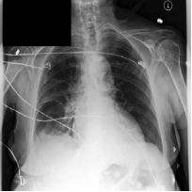
Examples
Target：
"AP chest compared to ___: Mediastinal veins are not appreciably dilated. Heart size is top normal. There might be a small residual of edema in the right mid and lower lung zones, particularly since there is a new small right pleural effusion. Left lung is clear aside from basal atelectasis which is also probably present on the right. Heart size top normal, unchanged. No pneumothorax."
Generated：
'AP radiograph of the chest was reviewed in comparison to ___. Heart size and mediastinum are stable. There is interval development of interstitial pulmonary edema. There is no pneumothorax or pneumomediastinum. The pleural effusions are minimally increased as compared to the prior study, and there is no focal airspace consolidation to suggest infectious process.'
Presenter: Jiabei Wu(z5597215)

Slide 27
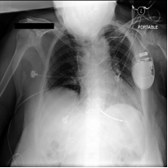
Examples
Target:
Mild cardiomegaly is chronic, exaggerated by low lung volumes, which also make the pulmonary vasculature local more engorged, but I do not think there is ANY good evidence for congestive heart failure. Certainty there is no pulmonary edema or appreciable pleural effusion. Left subclavian pacer defibrillator lead follows the expected course to the floor of the right ventricle.
Generated:
'There is little change in the degree of pulmonary edema. There is no evidence for congestive heart failure. Cardiac silhouette remains mildly enlarged with mild tortuosity of the thoracic aorta. Left subclavian catheter extends to the mid portion of the SVC. No evidence of acute focal pneumonia or pleural effusions.'
Presenter: Jiabei Wu(z5597215)

Slide 28
Discussion
Peidong Liang z5603156

Slide 29
Discussion-Key Findings
Best Model: ViT-label-RadScribe is the top performer.
This model achieved a comprehensive lead in key metrics for both text quality (e.g., CIDEr, BLEU-4) and clinical accuracy (Clinical_F1), making it the clear winner of this experiment.
Architectural Advantage: ViT outperforms CNNs.
The models based on the Vision Transformer (ViT) architecture systematically outperformed those based on ResNet and DenseNet. This indicates that ViT is more adept at capturing the necessary image features for generating radiology reports.
Presenter: Peidong Liang (z5603156)

Slide 30
Discussion-Comparison&Analysis
Observations:
Significant Improvement for ViT:
Comparing ViT-label-RadScribe and ViT-RadScribe, the -label variant delivers clear and consistent improvements across almost all key metrics.
Minimal Gains for CNNs:
For ResNet and DenseNet, adding the -label suffix yields performance that is very close to the original versions
Reasons:
Explicit Supervision Signal:
This approach forces the model to learn image feature representations that are highly relevant to clinical concepts.
Regularization Effect:
Handling multiple tasks restricts the model’s parameter space, preventing it from overfitting to the primary task and thereby enhancing generalization.
Presenter: Peidong Liang (z5603156)

Slide 31
Discussion-Comparison&Analysis
Why Does the -label Strategy Benefit ViT More Than CNNs?
Vision Transformer (ViT):
ViT splits an image into multiple patches and analyzes their relationships using a self-attention mechanism, enabling it to capture long-range dependencies and global context.
Synergistic Effect:
Predicting clinical labels inherently requires global comprehension of the image.
CNNs (ResNet/DenseNet):
CNNs operate through stacked convolution and pooling layers, building features from local to global in a hierarchical manner.
Presenter: Peidong Liang (z5603156)

Slide 32
Discussion-Strengths & Innovations
Unified evaluation framework:
comprehensive comparison of three major vision encoders
Clear guidance for clinical deployment choices
Label augmentation mechanism:
+20% Clinical F1, +15-18% text quality
Demonstrates value of structured medical knowledge
Efficient training methods:
By freezing the shallow layers of the encoder and fine-tuning the deeper layers
Presenter: Peidong Liang(z5603156)

Slide 33
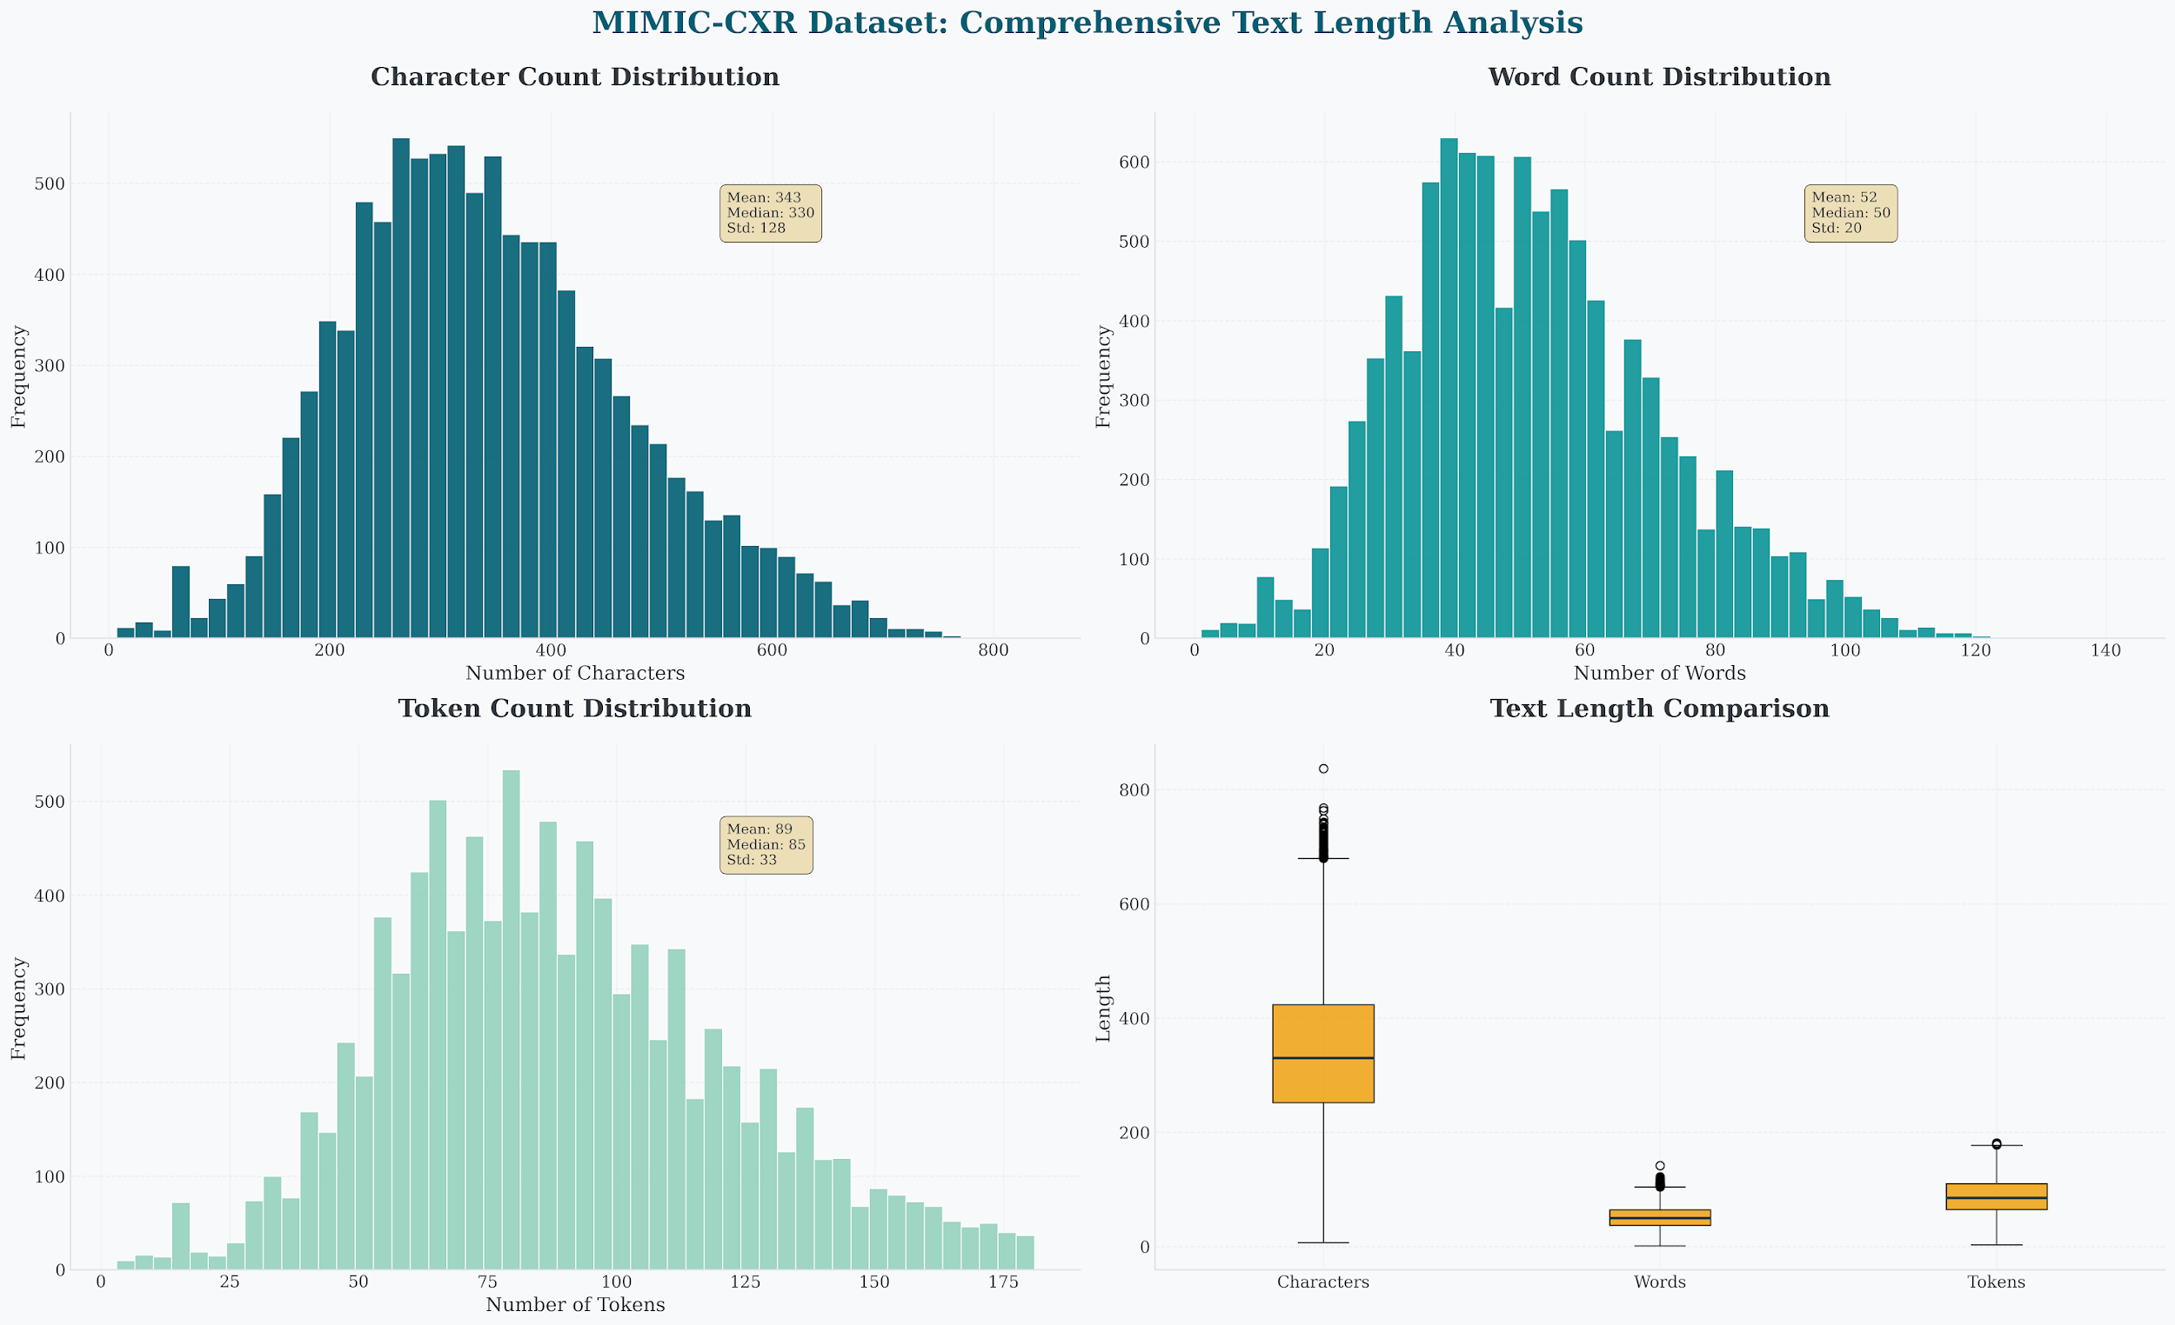
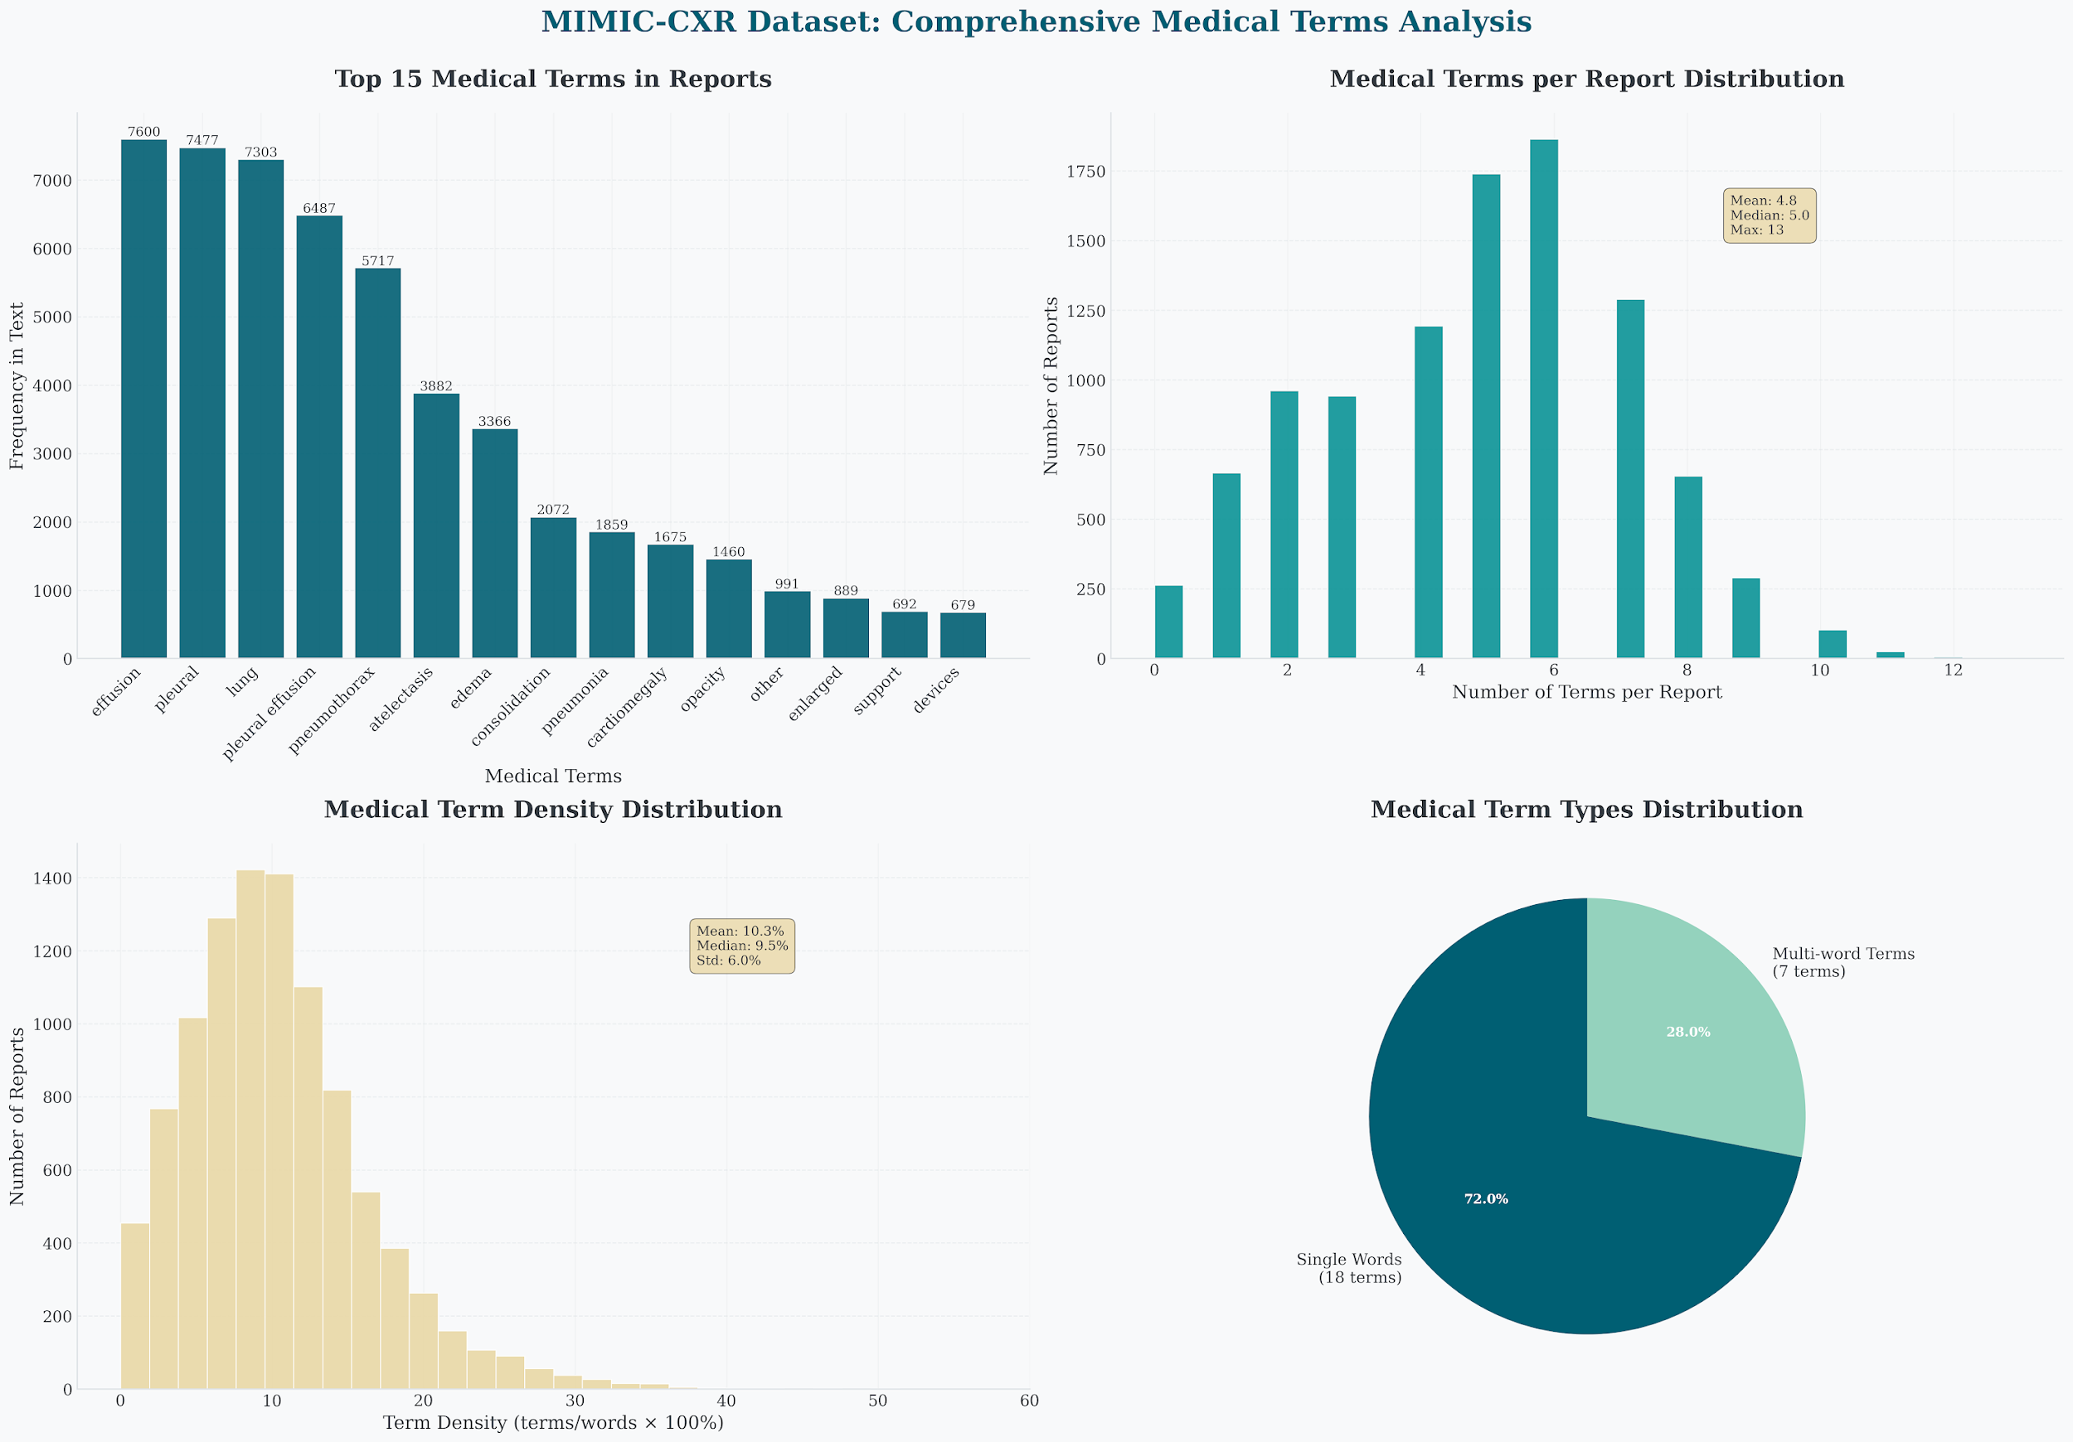
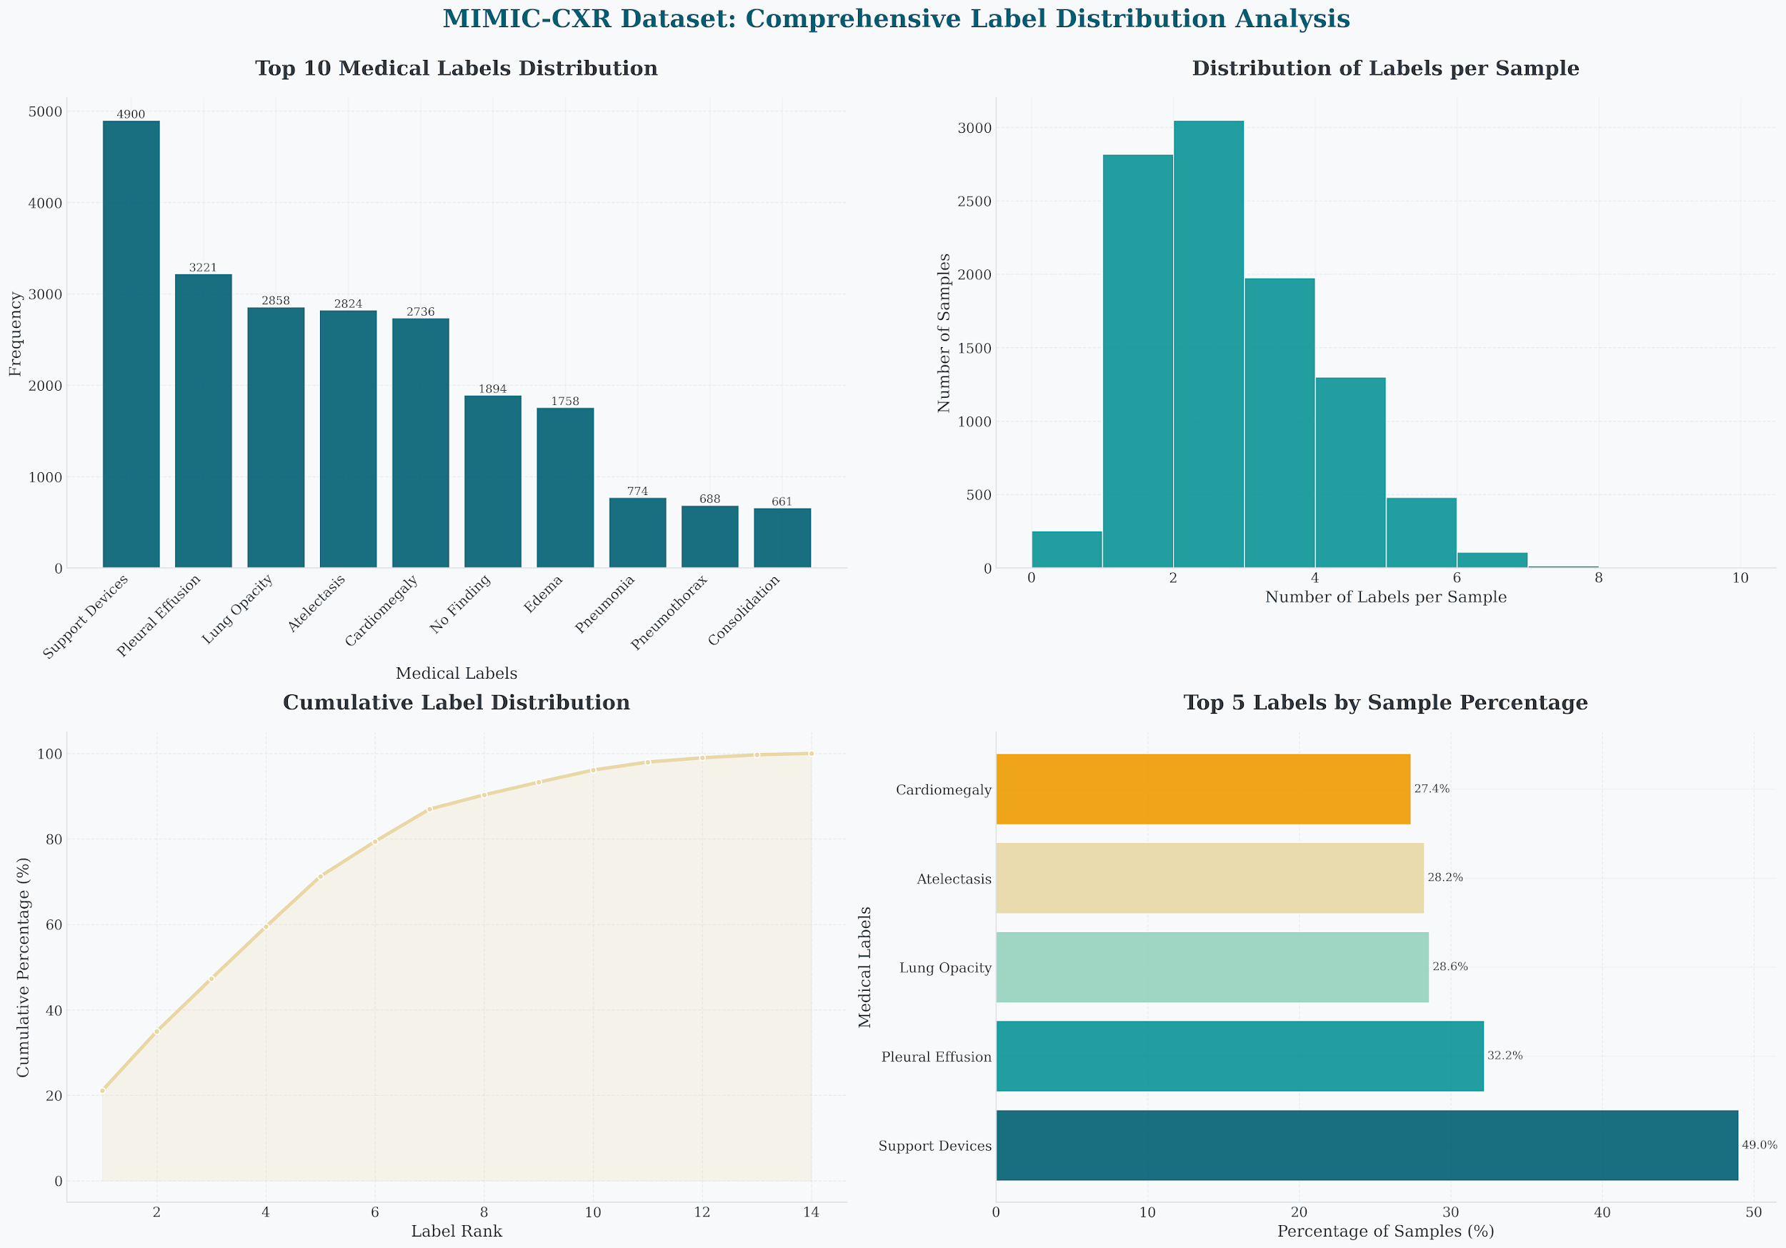
Discussion-Limitations & Future Work
Current Limitations:
Dataset Insufficiency: only a subset of MIMIC-CXR used, missing rare pathologies，English-only reports
Limited Training Data: volume/steps insufficient to fully exploit capacity
Single-View Only: PA view without lateral or historical images
AI Legal Liability: regulatory and liability frameworks for AI-generated reports remain unclear
Presenter: Peidong Liang(z5603156)

Slide 34
Discussion-Limitations & Future Work
Future Work:
Multi-view Integration:
Develop models capable of processing both posteroanterior (PA) and lateral (L) images.
Data Expansion:
Migrate to the full MIMIC-CXR dataset and incorporate additional public datasets to increase the sample size of rare pathologies.
Extended Training:
Significantly increase the number of training steps for the current best model until all key metrics fully converge.
Optimization Strategies:
Explore more advanced learning rate schedulers or optimizers to accelerate and stabilize the convergence process.
Presenter: Peidong Liang(z5603156)

Slide 35
Conclusion
Peidong Liang z5603156

Slide 36
Conclusion
Looking back on our study,
this experiment systematically compared the performance of various vision encoders on automated radiology report generation within a relatively comprehensive and unified evaluation framework.
While there remain many limitations in our work, we will continue to strive for further improvements in the future.
Key Takeaway
“There is no one-size-fits-all model — the best choice depends on clinical needs.”
Presenter: Peidong Liang (z5603156)

Slide 37
Reference
Moon, J. H., Lee, H., Shin, W., Kim, Y. H., & Choi, E. (2022). Multi-modal understanding and generation for medical images and text via vision-language pre-training. IEEE Journal of Biomedical and Health Informatics, 26(12), 6070-6080.
Rajpurkar, P., Irvin, J., Zhu, K., Yang, B., Mehta, H., Duan, T., ... Ng, A. Y. (2017). Chexnet: Radiologist-level pneumonia detection on chest x-rays with deep learning. arXiv preprint arXiv:1711.05225.
Cohen, J. P., Brooks, R., En, S., Zucker, E., Pareek, A., Lungren, M. P., & Chaudhari, A. (2021, August). Gifsplanation via latent shift: a simple autoencoder approach to counterfactual generation for chest x-rays. In Medical Imaging with Deep Learning (pp. 74-104). PMLR.
Tayebi Arasteh, S., Misera, L., Kather, J. N., Truhn, D., & Nebelung, S. (2024). Enhancing diagnostic deep learning via self-supervised pretraining on large-scale, unlabeled non-medical images. European Radiology Experimental, 8(1), 10.
Lehman, E., Hernandez, E., Mahajan, D., Wulff, J., Smith, M. J., Ziegler, Z., ... Szolovits, P. (2023). ClinicalT5: Large Language Models Built Using MIMIC Clinical Text. In Proceedings of Machine Learning for Healthcare Conference.

Slide 38

Thank you!
This Photo by Unknown Author is licensed under CC BY-SA

